Slide 1
Final year project progress presentation
Wes Gaunt
11 December 2019

Slide 2
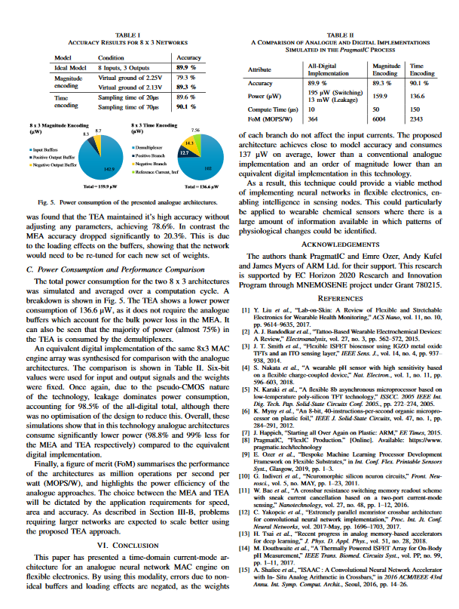
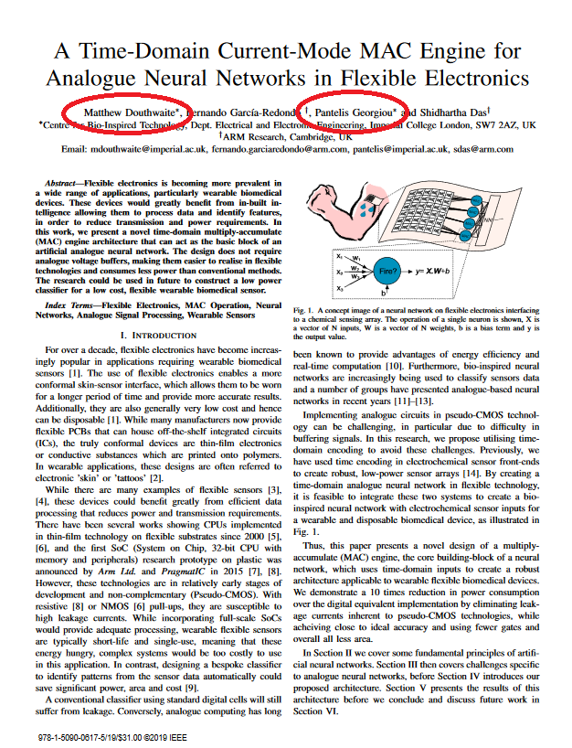


Time domain 0.18µm CMOS analogue MAC for neural networks
Previous work (Matt & ARM)
‘Psuedo’ CMOS
Coming up…
What?
Why?
How?

Slide 3
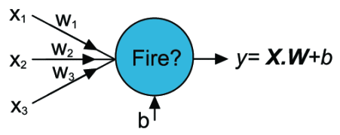
Time domain 0.18µm CMOS analogue MAC for neural networks
Multiply ACcumulate operation
Single neuron performs the operation:
y = XW + b
X and W are vectors of length n.
y and b is are scalars

Slide 4
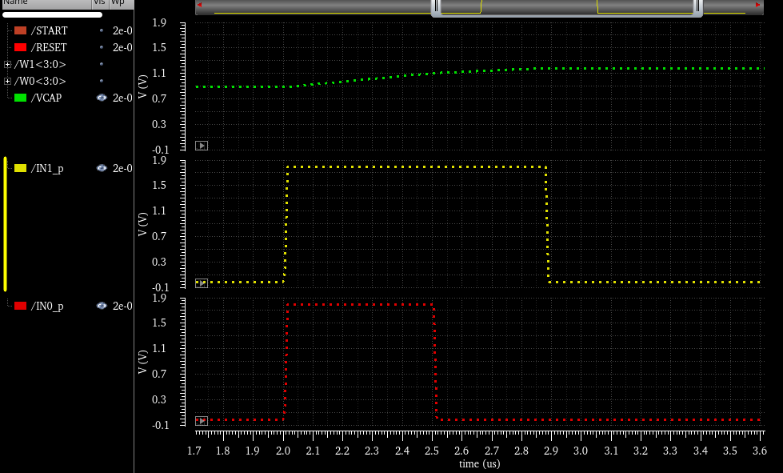
Time domain 0.18µm CMOS analogue MAC for neural networks
Inputs are scaled using pulse width.
Long pulse = high magnitude (of x)
Short pulse = low magnitude

Slide 5
Time domain current to voltage?
Capacitor
CURRENT (mode) x TIME (domain) = (change in) CHARGE
@t = 0. Vcap = VDD/2 = 0.9V

Slide 6
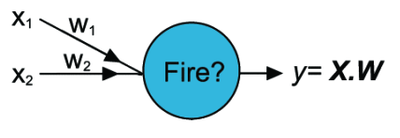

2 input neuron example (no offset)
$y=XW=\left[\begin{matrix}x_{0} & x_{1}\end{matrix}\right]\left[\begin{matrix}w_{0} \\ w_{1}\end{matrix}\right]=x_{0}w_{0}+x_{1}w_{1}$

Slide 7
How?
Conventional CMOS (TSMC 180nm)
Binary weighted (W) current mirror (X)
Leads to W.X…

Slide 8
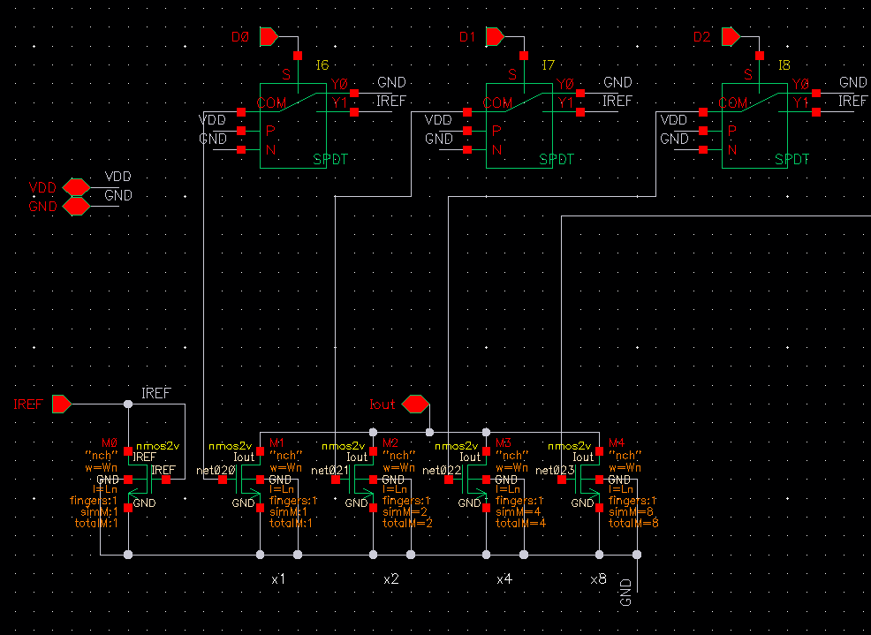
First current mirror
Binary weighted ->
4 bits = 0..15
LSB = 0.067
Current mirror ->
NMOS version

Slide 9
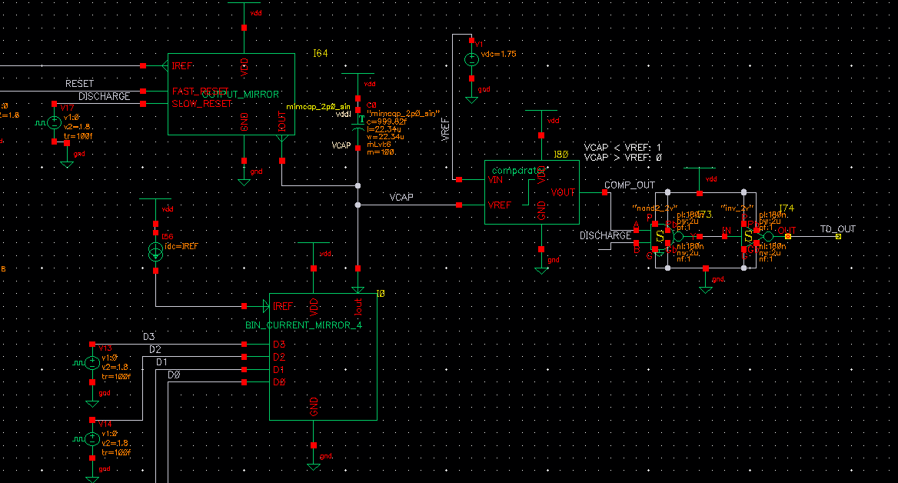
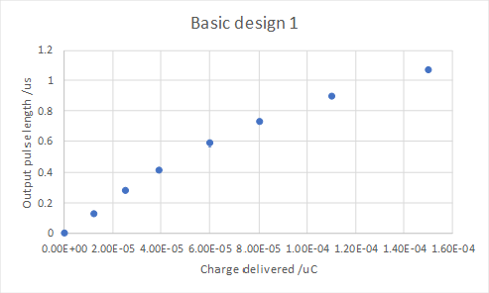
Time domain output
Need output mirror to ‘reset’ the capacitor.

Slide 10
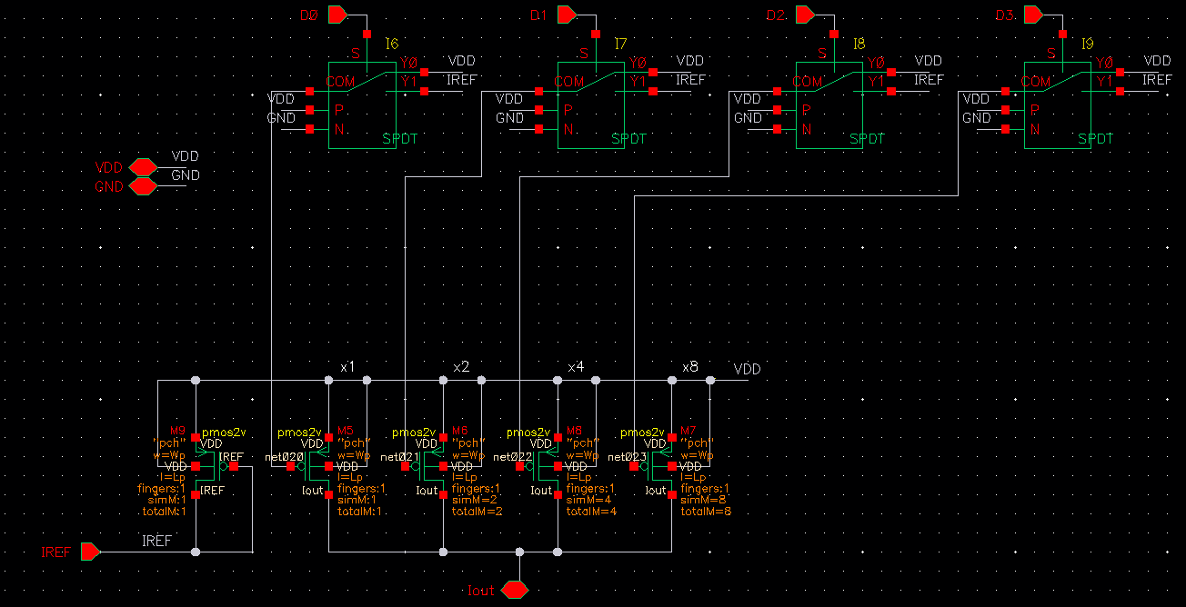
Complementary (CMOS) mirrors (1)
PMOS

Slide 11
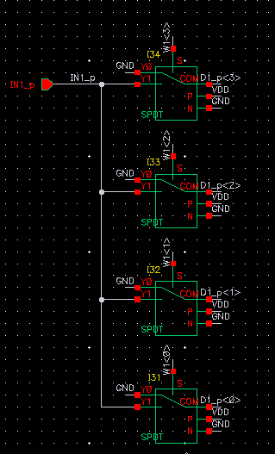
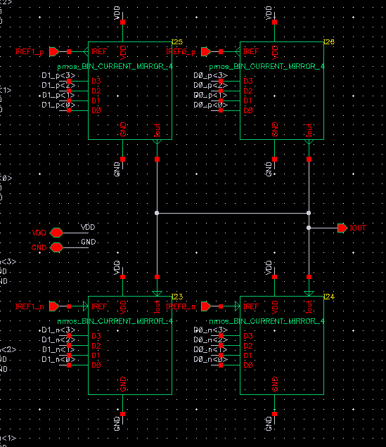
Complementary (CMOS) mirrors (2)
PMOS source current, VCAP increases.
NMOS sink current, VCAP decreases.

Slide 12
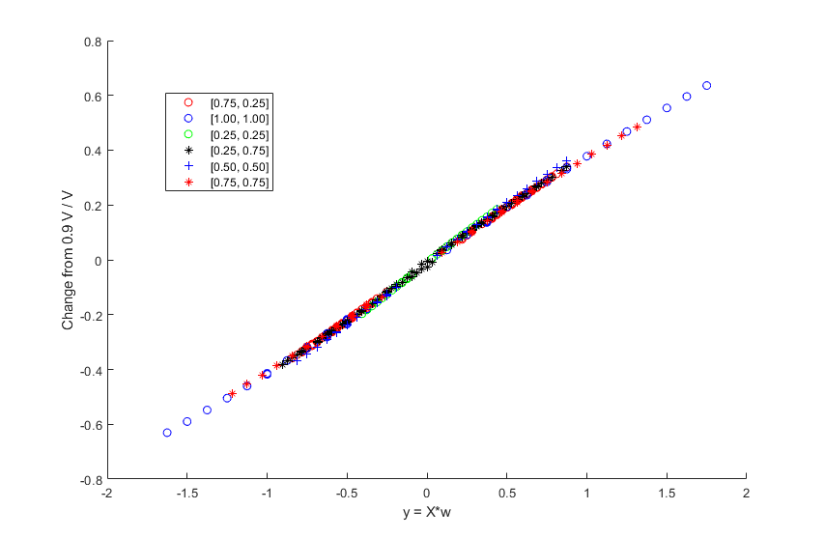
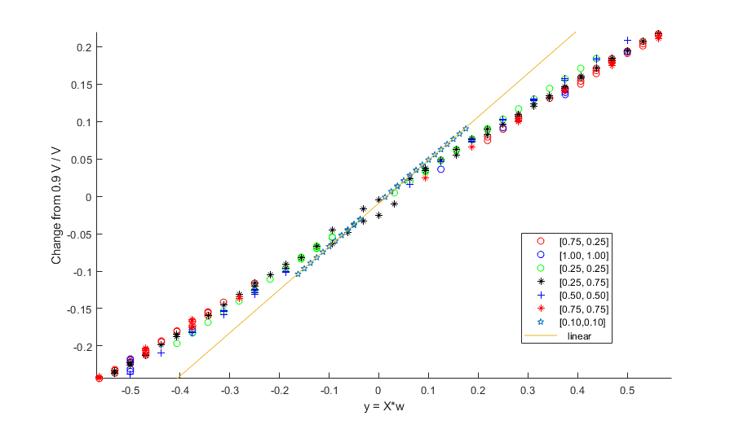
Preliminary results
200 pairs of inputs.
1 pair of weights for each set of 200 inputs.
Binary output: >= 0.9V?
Compared with MATLAB results.
Voltage domain
100% accuracy
Low resolution issues.

Slide 13
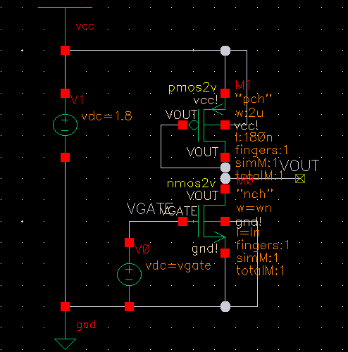
Next steps
More inputs
b input
Handle negative inputs and weights
Time domain output
Time domain weighting: time x capacitor x VCCS:

Slide 14
Questions, queries & concerns

